Slide 1
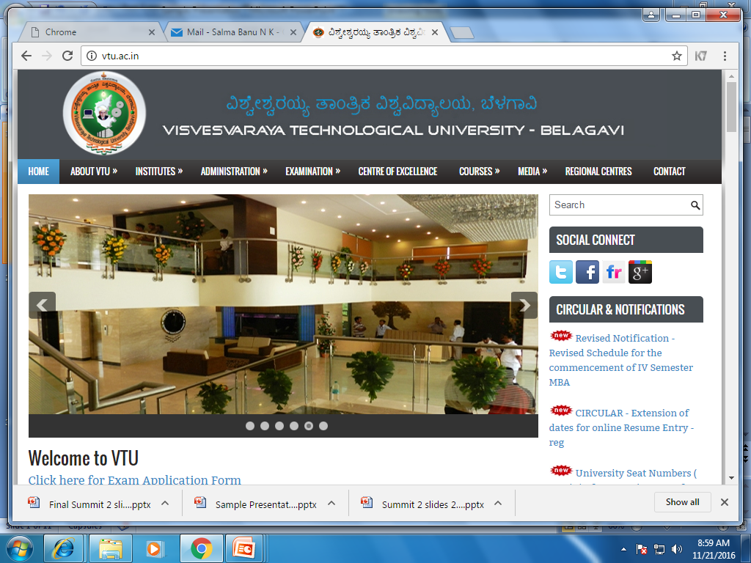
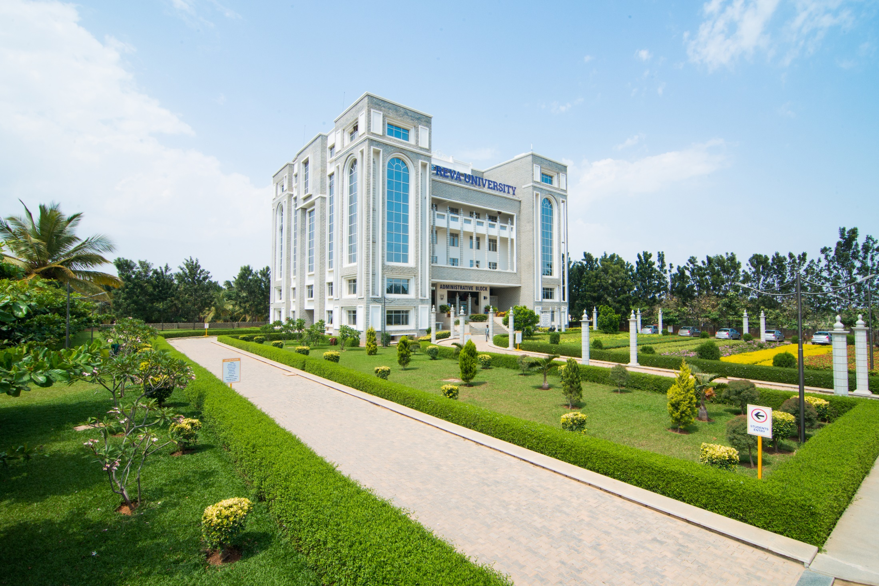
REVA INSTITUTE OF TECHNOLOGY AND MANAGEMENT
DEPARTMENT OF COMPUTER SCIENCE & ENGINEERING
<number>
Dept. of CS&E
0x4bdn

Slide 2
8th Semester Project Proposal Presentation on
Code Integration System
<number>
Dept. of CS&E
0x4bdn

Slide 3
Code Integration System
Presented By,
Midhun Mathew (1RE13CS088)
Ruhil Jaiswal (1RE12CS085)
Karthik Hegde (1RE13CS062)
Under the Guidance of
Dr.M Prabhakar,
Associate Professor
<number>
Dept. of CS&E
0x4bdn

Slide 4
Content
Introduction
Abstract
Hardware/Software Requirements
Methodology/ Technique to be applied
Advantages
Scope for future work
Conclusions
References
<number>
Dept. of CS&E
0x4bdn

Slide 5
Introduction
In this age of rapid growth of technology, programmers write millions of lines of codes everyday.
What if we could develop a system that finds the best implementation for a functionality.
And what if this system could provide re-usability of the code for everyone?
<number>
Dept. of CS&E
0x4bdn

Slide 6
Abstract
Currently few to none applications are available that compares programs and analyzes their efficiencies.
The system analyzes the code, stores the most efficient functions in the code repository as and when encountered.
The major modules of this system are :
i.A performance evaluator engine
ii.Central repository
iii. Testing unit
<number>
Dept. of CS&E
0x4bdn

Slide 7
Hw/Sw Requirement
Software requirements :
Operating System :
server: Linux (ubuntu 16.04)
database: Linux (ubuntu 16.04) / windows
Tools: Python, Mongodb, CherryPy, Docker
Hardware requirements ( developed on )
Processor : intel core i5
Memory : 4GB Ram or higher
Hard disk space : 2GB or more
Note : system requirements maybe subjected to change.
<number>
Dept. of CS&E
0x4bdn

Slide 8
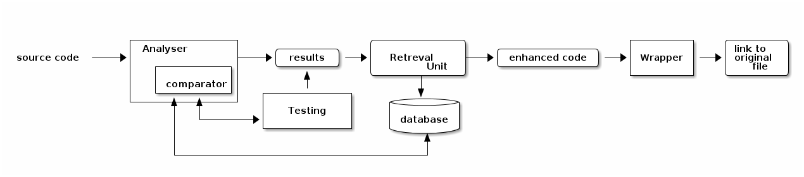
Methodology/ Technique to be applied
<number>
Dept. of CS&E
0x4bdn

Slide 9
Advantages
reusability of code
multi language compatibility
compare code
assessments
ranking
visual results for the function
retrieval of functions, mapping with tags
testing using restrictions/ constraints on the input
<number>
Dept. of CS&E
0x4bdn

Slide 10
Scope for future work
handling the library requirements for the function
tag based retrieval ( porting / eval function)
visual aspects for code development ( flowcharts, class diagram)
optimization
analyser improvements to identify syntax of code
<number>
Dept. of CS&E
0x4bdn

Slide 11
Conclusions
visual aid for development and analysis
compare code of different languages
reduced plagiarism
credit for work
frequent enhancements
<number>
Dept. of CS&E
0x4bdn

Slide 12
References
Enrique FLores ,Alberto Barron-Cedeno Towards the Detection of Cross-Language Source Code Reuse(2011)
Arwin, C., Tahaghoghi, S.M.M.: Plagiarism Detection across Programming Languages
D. Binkley "Source Code Analysis: A Road Map" IEEE Future of Software Engineering (FOSE'07)2007.
<number>
Dept. of CS&E
0x4bdn

